Slide 1
Content augmentation for efficient content moderation
Xuemeng Yan - 16210083
Mualeoa Leo – 71032006
Jack Xiao - 29223034
Karume Rajab (Kay) - 41768325
Uditha Mayadunna - 39768450

Slide 2

Introduction
Social media platforms must have effective content moderation. They need to be able to filter out any content that goes against the platforms' community guidelines. However, what happens when content moderation teams come across content that contains culturally specific references? For instance, what if a moderating team doesn't have a firm grasp on "Māori words and New Zealand slang" and they come across content that uses these expressions? In this case, moderating the content could move into the arena of a "daunting task”—something that could also easily lead to misinterpretation.
Our group proposed dealing with this problem by implementing an algorithm that can identify culturally specific content (like the aforementioned "Māori words") and on the moderation's side, provide "supplementary information" that can help in making the correct decision.

Slide 3


Ethical Issue
Language usage and slang can vary significantly across regions.
Subtleties in language can lead to misinterpretation of content.
Importance of understanding local dialects and expressions.
Moderators’ decisions may be influenced by their own cultural context.
Potential for incorrect judgments leading to user dissatisfaction and backlash.

Slide 4
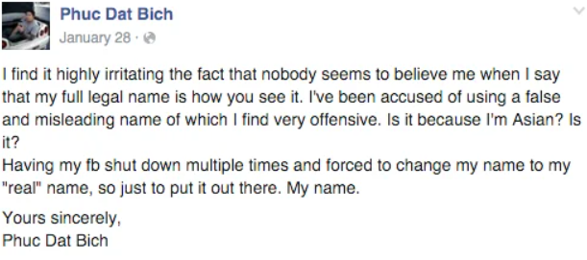
Ethical Issue
Case Study: Phuc Dat Bich (2015)
Profile: 23-year-old Vietnamese-Australian, works in banking.
Issue: His Facebook profile has been repeatedly shut down.
Reason: His name was flagged by Facebook’s moderation systems as inappropriate.
User's Experience: Describes the repeated account shutdowns as “highly irritating”.
Impact: Frustration due to misidentification and repeated verification processes.

Slide 5

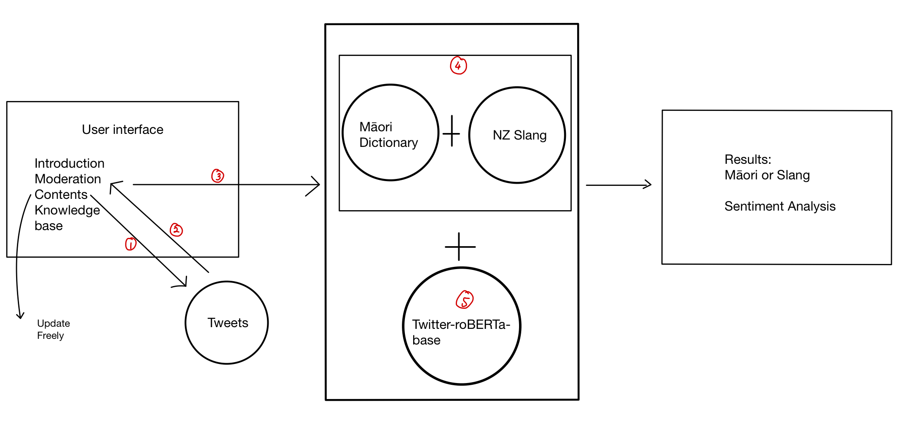
Methodology

Slide 6
Tools
Streamlit: open source Python library
Twitter-roBERTa-base for Sentiment Analysis:
Labels: 0 -> Negative; 1 -> Neutral; 2 -> Positive

Slide 7
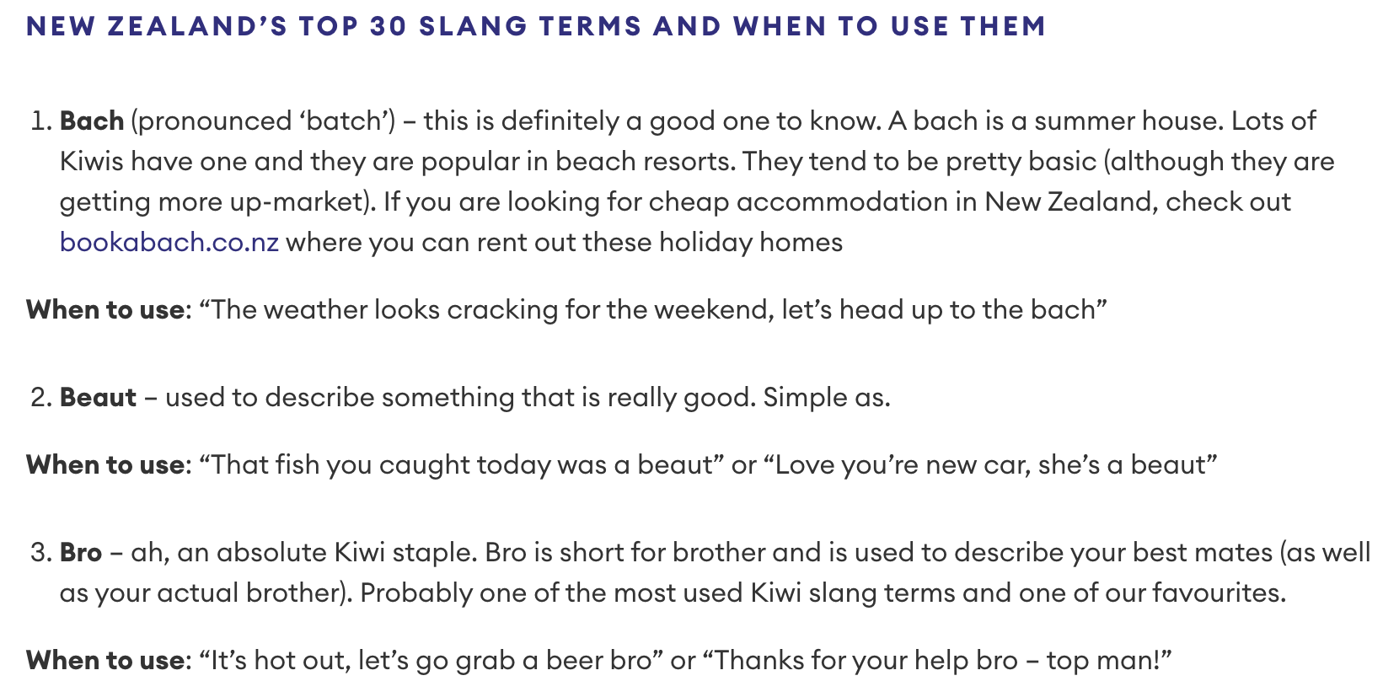
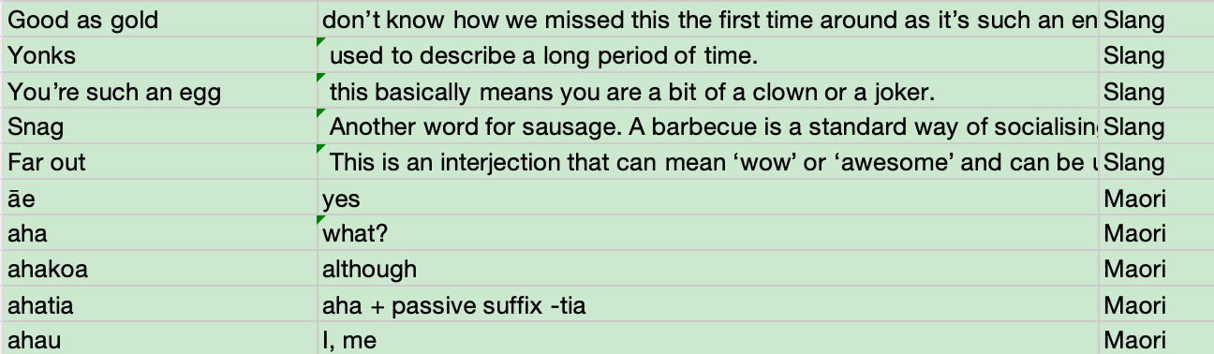
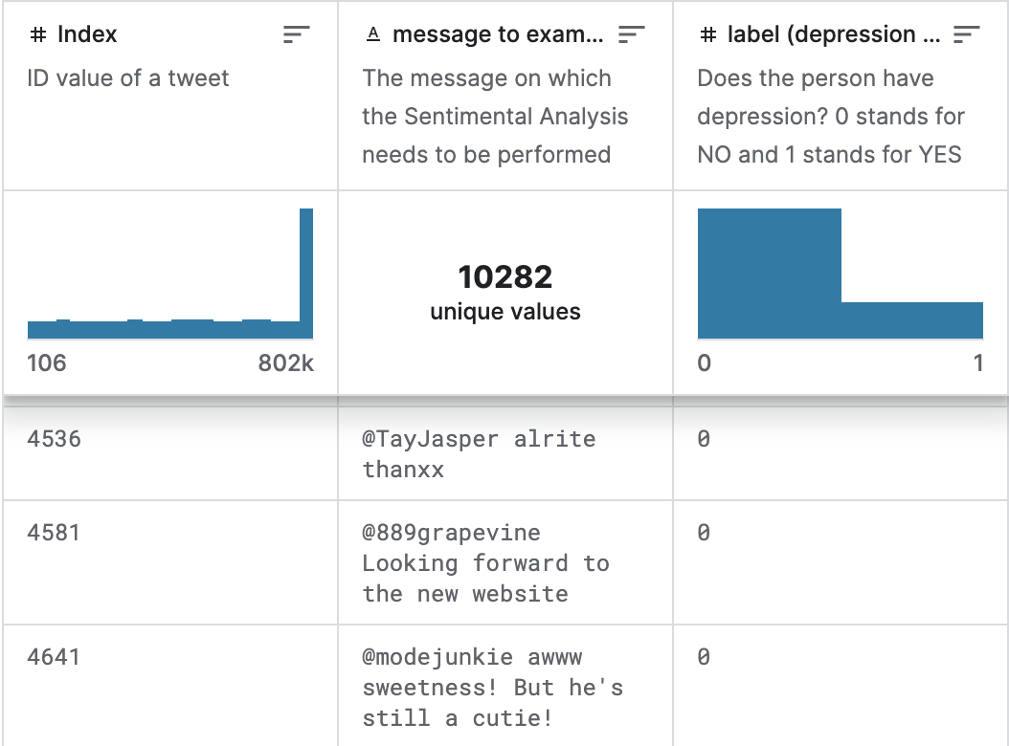
Dataset
Maori Dictionary
nz slang
Database of tweets to perform
Sentimental Analysis(Kaggle)

Slide 8

Algorithm
Load the database and content(posts)
Run match between the content and the words in database
Highlight the text which were matched with the database
Display the highlighted text with definitions
Run sentiment analysis to get the scores
Check the cumulative negative score with the threshold

Slide 9
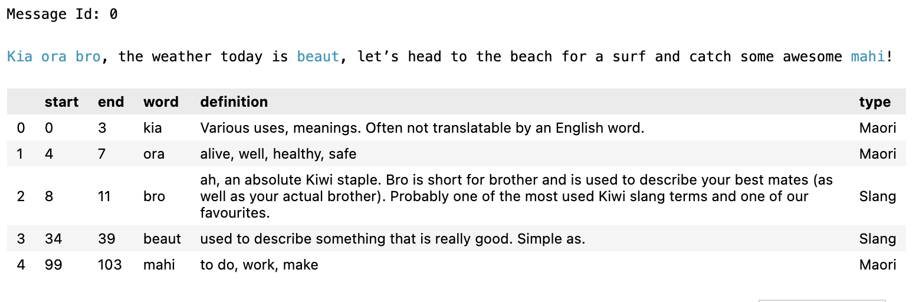
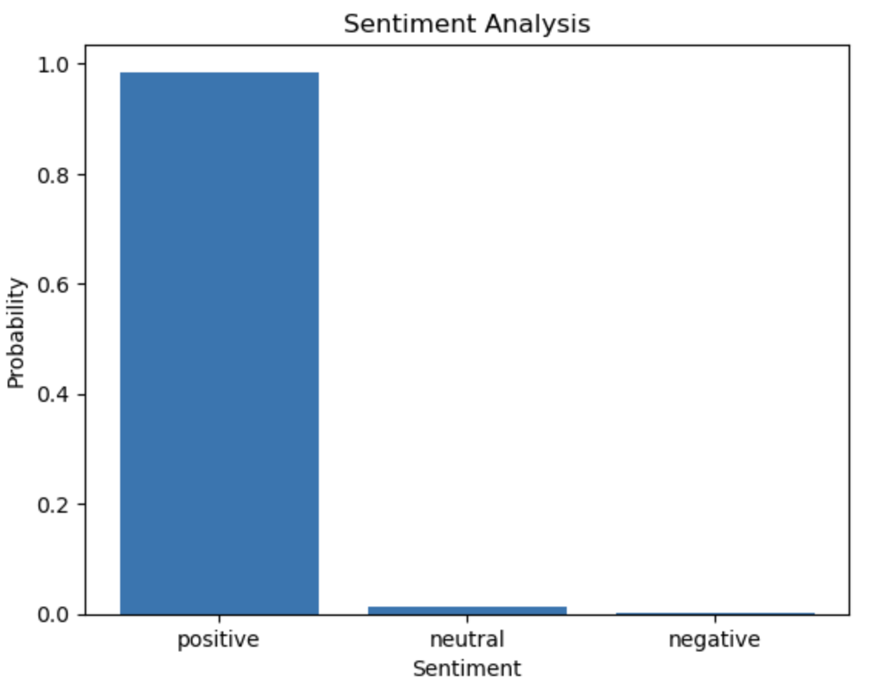
Deliverables
The deliverables of this project aim to provide comprehensive coverage of the project.
Report: A Detailed report documented the goal, issues, methodologies, and discussions of the project.
Notebook: A Jupyter Notebook script showcasing the flows and key algorithms.
Demo Website: A demo website to present
Cultural keywords highlighting and descriptions
Moderator Psychological Wellbeing
Cumulative negative score
Min
Max
The moderator should rest
when reaching the threshold.

Slide 10
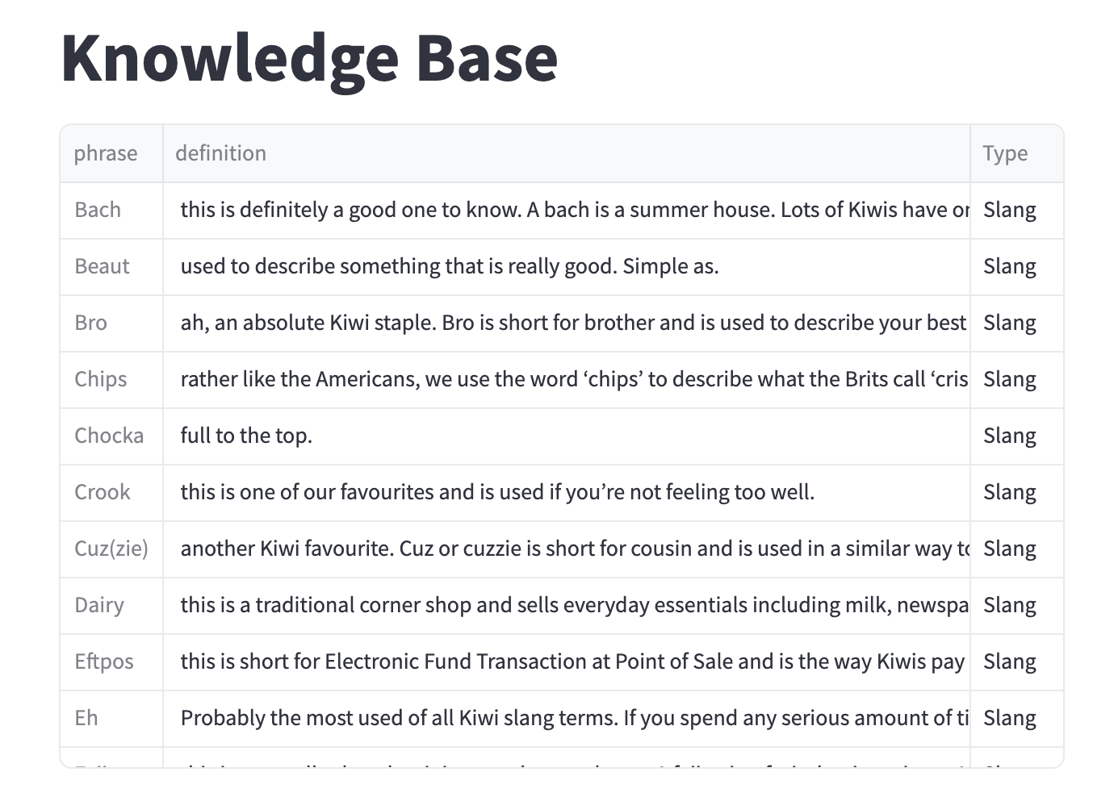
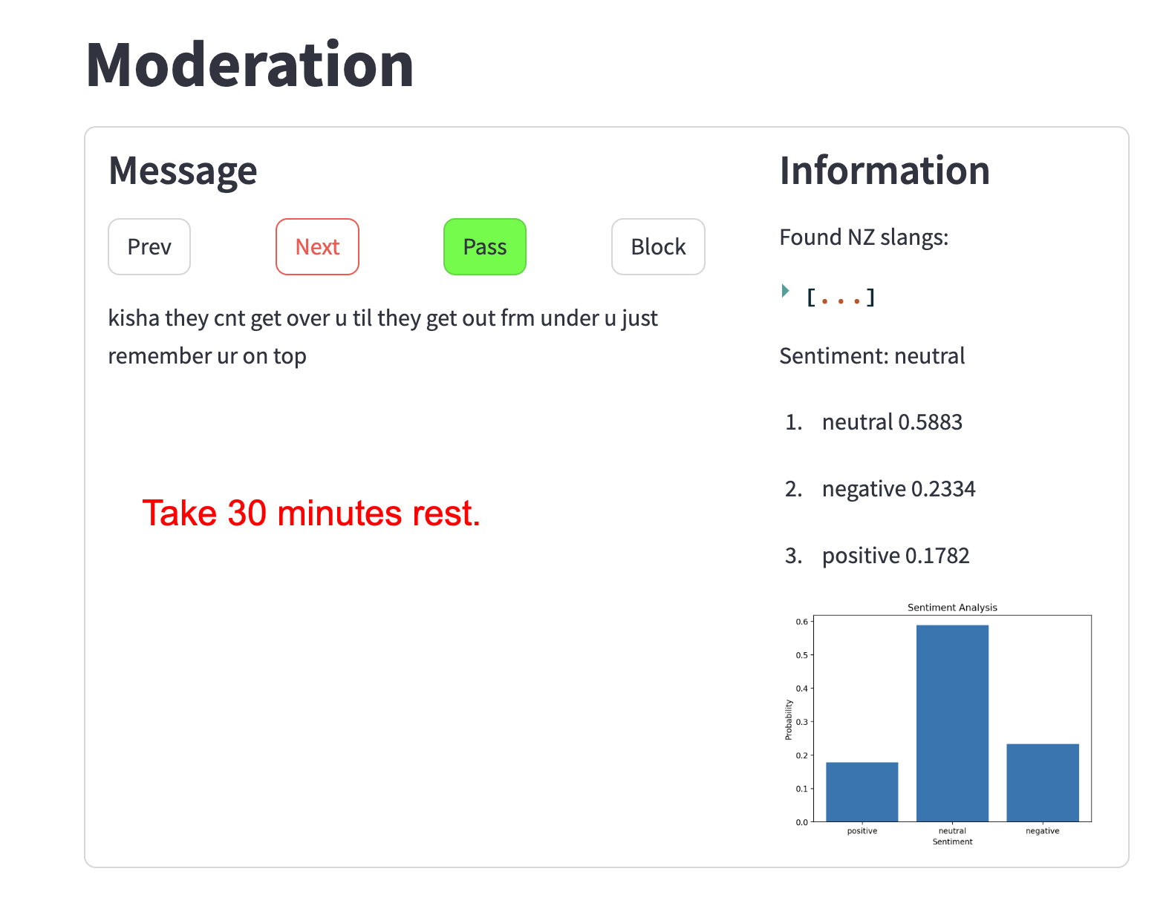
Deliverables – Demo websites

Slide 11
Conclusion
In conclusion, our suggested algorithm empowers "content moderators" to comprehend culturally specific references they may encounter when evaluating "user-generated content." If not handled properly, this content can heavily impact the intersectionality of the people who inhabit an algorithmic environment. It is those very same people who must navigate the digital spaces with authority and grace. This can only be accomplished if we ensure that the same people who should be seen and heard are and that they feel safe and respected when doing so.

